Slide 1
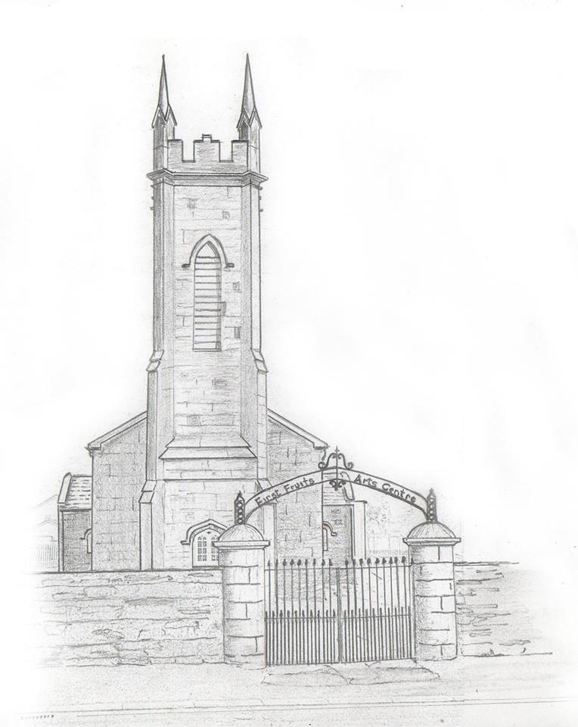

HILLFEST is run by a sub-committee of
Watergrasshill Community Association.
Funds generated from HILLFEST go towards many projects like the Watergrasshill National School Parents Association & Watergrasshill Community Association specific projects.
Watergrasshill Community Association
HILLFEST

Slide 2
Community Association

Slide 3
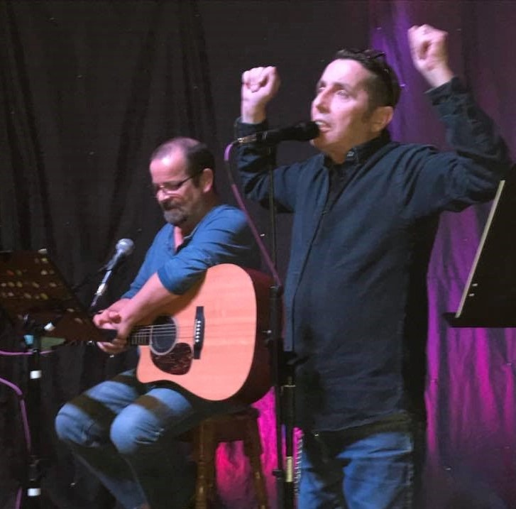
The Community Association via the Community Centre & First Fruits Arts Centre promote live music, arts & culture, poetry evenings (many events were FREE), kids disco & movie afternoons. These facilities provide two great resources to the community during HILLFEST and throughout the year.
MUSIC, ARTS & CULTURE

Slide 4
Community Association
Music, Arts & Culture

Slide 5

Since 2013, HILLFEST has contributed funds to:
FUNDING
COMMUNITIES
Local Clubs
WGH National School Astro facility
The ASD unit in our national school
Community outdoor defibrillator
Funding for our Arts Centre
It has also given an annual fundraising platform to ALL local clubs and numerous charity partners: Pieta House, Le Cheile Africa, Children’s Hospitial Crumlin, CUH Charity, Development Pamoja all whom have strong direct local community involvement.

Slide 6
Community Association
Music, Arts & Culture
Funding Communities

Slide 7
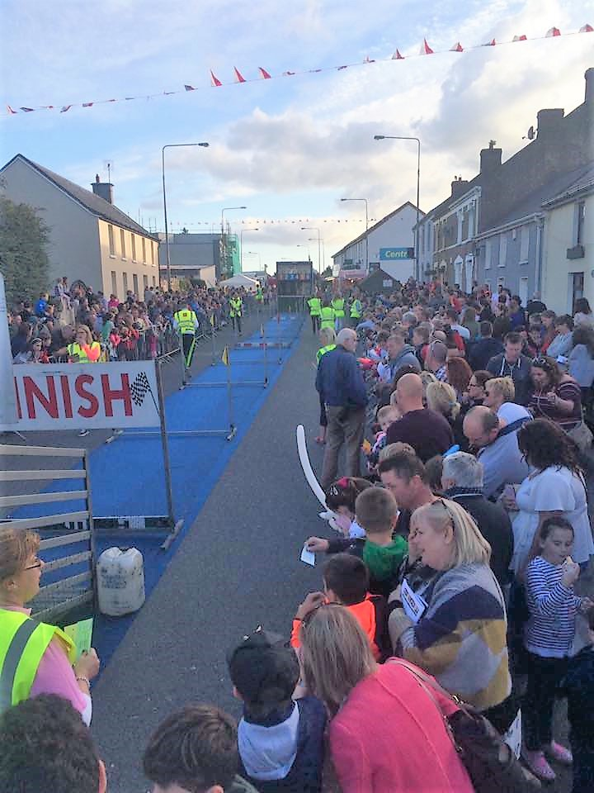
The closure of the Main Street for numerous fun events during HILLFEST ensures friends & neighbours interact, provide a safe environment for the kids and promote a strong sense of community .
Through continuous PR, we raise the profile of Watergrasshill village & local businesses.
BUILDING
COMMUNITY SPIRIT

Slide 8
Community Association
Music, Arts & Culture
Funding Communities
Building Communities

Slide 9
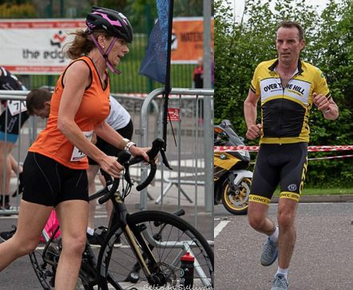
The National School gives their facilities to Over The
Hill Cycling Club and Watergrasshill AC for their annual HILLFEST Duathlon fundraiser.
Strong collaboration between these two clubs ensures a continued successful event.
WATERGRASSHILL AC &
OVER THE HILL CYCLING CLUB

Slide 10
Community Association
Music, Arts & Culture
Funding Communities
Building Communities
Watergrasshill AC &
Over The Hill Cycling Club

Slide 11
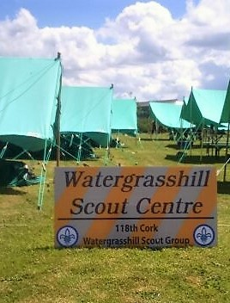
Watergrasshill 118th Scout Group give access to the Scout Centre to Watergrasshill AC and Over The Hill Cycling Club for parking to assist in the HILLFEST Duathlon running smoothly.
WATERGRASSHILL
118th SCOUTS

Slide 12
Community Association
Music, Arts & Culture
Funding Communities
Building Communities
Watergrasshill AC &
Over The Hill Cycling Club
Watergrasshill Scouts

Slide 13
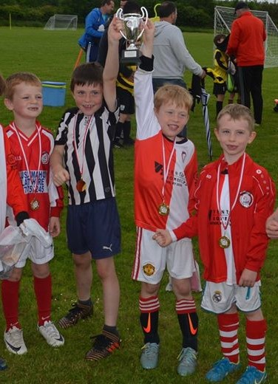
The soccer club run their biggest tournament of the year during HILLFEST showcasing their facilities to numerous Clubs & utilize the school astro for winter training.
The over 35 tournament encourages locals & neighbours to participate & compete and relive their dreams.
Watergrasshill United permit 118th Scout Group to run a BBQ stand as a fundraiser at their Academy Soccer Tournament.
WATERGRASSHILL
UNITED

Slide 14
Community Association
Music, Arts & Culture
Funding Communities
Building Communities
Watergrasshill AC &
Over The Hill Cycling Club
Watergrasshill Scouts
Watergrasshill Utd

Slide 15
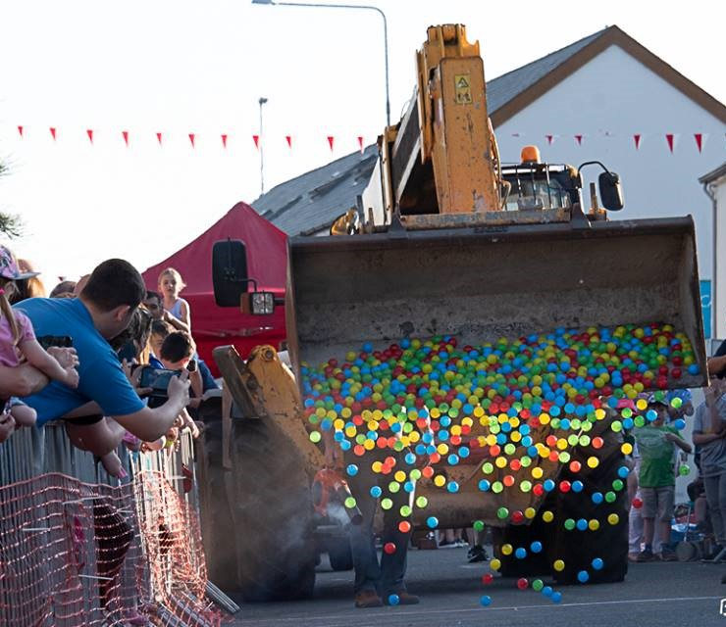
Watergrasshill Scouts organised a “Ball Drop” fundraiser on the Main Street and a Family Fun Day with BBQ in Moanbaun Woods as part of HILLFEST
WATERGRASSHILL
SCOUTS BALL DROP

Slide 16
Community Association
Music, Arts & Culture
Funding Communities
Building Communities
Watergrasshill AC &
Over The Hill Cycling Club
Scouts Ball Drop
Watergrasshill Scouts
Watergrasshill Utd

Slide 17
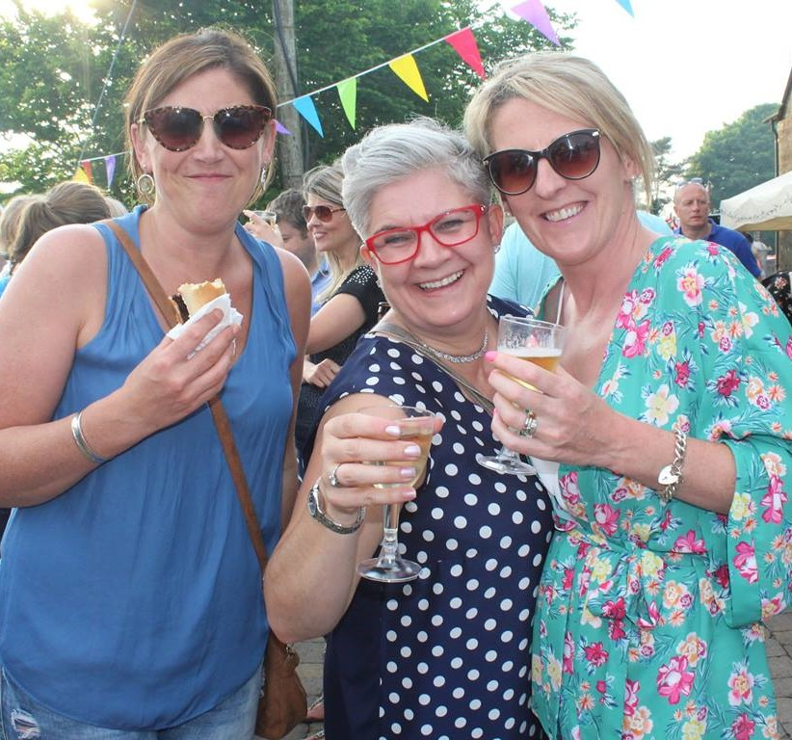
Watergrasshill Hurling Club held a FÉILE fundraising BBQ, assisted by the Scout Group, Community Association members and volunteers at the First Fruits Arts Centre with over 400 attending. They also sold a huge amount of FÉILE raffle tickets “on the street” during HILLFEST.
They also use the school astro for winter training.
WATERGRASSHILL
HURLING CLUB

Slide 18
Community Association
Music, Arts & Culture
Funding Communities
Building Communities
Watergrasshill
Hurling Club
Watergrasshill AC &
Over The Hill Cycling Club
Scouts Ball Drop
Watergrasshill Scouts
Watergrasshill Utd

Slide 19
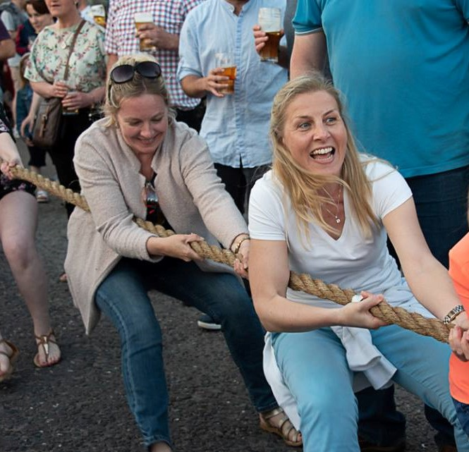
Members of the local Glenhill Tug of War Club help run the Annual HILLFEST Tug Of War Competition with various community groups taking part – Watergrasshill United, Watergrasshill Scouts and local groups.
GLENHILL
TUG OF WAR

Slide 20
Community Association
Music, Arts & Culture
Funding Communities
Glenhill
Tug of War
Building Communities
Watergrasshill
Hurling Club
Watergrasshill AC &
Over The Hill Cycling Club
Scouts Ball Drop
Watergrasshill Scouts
Watergrasshill Utd

Slide 21
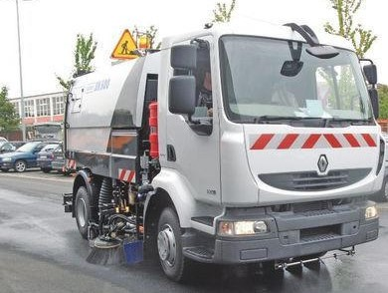
HILLFEST helps our Tidy Towns group, by using a professional road sweeper machine and proper removal of all rubbish.
This year the sweeper truck picked up 3 tonnes of litter, grit and dirt when the Main Street and environs were swept.
Our rule: We leave everyplace cleaner than when we arrived.
HELPING TO KEEP OUR VILLAGE CLEAN & TIDY

Slide 22
Community Association
Music, Arts & Culture
Tidy Towns
Funding Communities
Glenhill
Tug of War
Building Communities
Watergrasshill
Hurling Club
Watergrasshill AC &
Over The Hill Cycling Club
Scouts Ball Drop
Watergrasshill Scouts
Watergrasshill Utd

Slide 23
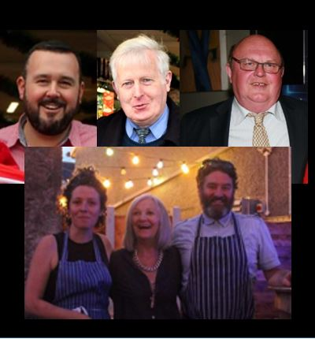
Sponsors make HILLFEST possible: local businesses, cash sponsors, product sponsors, loaning facilities.
But volunteers are the key ingredient: individuals, groups, community and sporting clubs all working together to give us this great weekend in our village.
SPONSORS &
VOLUNTEERS

Slide 24
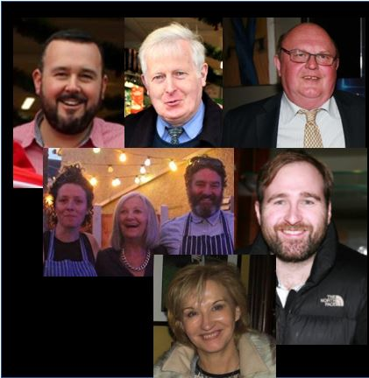
Sponsors make HILLFEST possible: local businesses, cash sponsors, product sponsors, loaning facilities.
But volunteers are the key ingredient: individuals, groups, community and sporting clubs all working together to give us this great weekend in our village.
SPONSORS &
VOLUNTEERS

Slide 25
Community Association
Businesses, Sponsors
Volunteers
Music, Arts & Culture
Tidy Towns
Funding Communities
Glenhill
Tug of War
Building Communities
Watergrasshill
Hurling Club
Watergrasshill AC &
Over The Hill Cycling Club
Scouts Ball Drop
Watergrasshill Scouts
Watergrasshill Utd

Slide 26

So the cycle starts again.
That’s what the HILLFEST platform and the Community Association offers: getting the Community, local people, clubs, and businesses working and helping each other.
We have a great parish with great community spirit & lots of people willing to help, let’s keep this community event going…!
CIRCLE OF
COOPERATION

Slide 27
Community Association
Cooperation & helping
Businesses, Sponsors
Volunteers
Music, Arts & Culture
Tidy Towns
Funding Communities
Glenhill
Tug of War
Building Communities
Watergrasshill
Hurling Club
Watergrasshill AC &
Over The Hill Cycling Club
Scouts Ball Drop
Watergrasshill Scouts
Watergrasshill Utd

